Slide 1
Project Presentation of Industry Oriented Hands on Experience (22CS422)
On
Deepfake Detection Using CNN
Supervised By
Dr. Monika Aggarwal
Department of Computer Science and Engineering,
Chitkara University, Punjab
Piyush Kapoor
Raghav Baluni
Prabal Rai
Rahul Choudhary
2210990651
2210990696
2210990657
2210990703

Slide 2
Introduction
Deepfake technology uses Artificial Intelligence (AI) and Deep Learning to create realistic fake images and videos.
It can manipulate facial expressions, voices, and identities, making fake content appear real.
Although deepfakes have applications in entertainment and media, they also pose serious threats such as misinformation, identity theft, and cybercrime.
Detecting deepfakes has become an important challenge in digital security and media authenticity.
This project proposes a Convolutional Neural Network (CNN)-based approach for identifying manipulated content with high accuracy.
2

Slide 3
Problem Statement
Deepfake technology can create highly realistic fake images and videos that are difficult to identify manually.
The misuse of deepfakes leads to misinformation, identity theft, cybercrime, and privacy issues.
Traditional detection methods are not effective against advanced AI-generated deepfakes.
There is a need for an automated and accurate CNN-based system to detect manipulated media and ensure digital authenticity.
3

Slide 4
Objective
To develop a deepfake detection system using Convolutional Neural
Networks (CNNs).
To identify and classify real and manipulated images/videos with high accuracy.
To analyze visual inconsistencies and features present in deepfake content.
To improve digital security and reduce the spread of misinformation through automated detection.
4

Slide 5
Methodology
Dataset Collection: Real and deepfake images/videos are collected from publicly available datasets such as FaceForensics++.
Data Preprocessing: Video frames are extracted, resized, normalized, and augmented to improve model performance and reduce overfitting.
CNN Model Development: A Convolutional Neural Network (CNN) is designed to automatically extract features and identify manipulated content.
Model Training and Testing: The dataset is divided into training and testing sets, and the CNN model is trained using deep learning techniques.
Performance Evaluation: The model is evaluated using metrics such as Accuracy, Precision, Recall, and F1-score to measure detection performance.
5

Slide 6
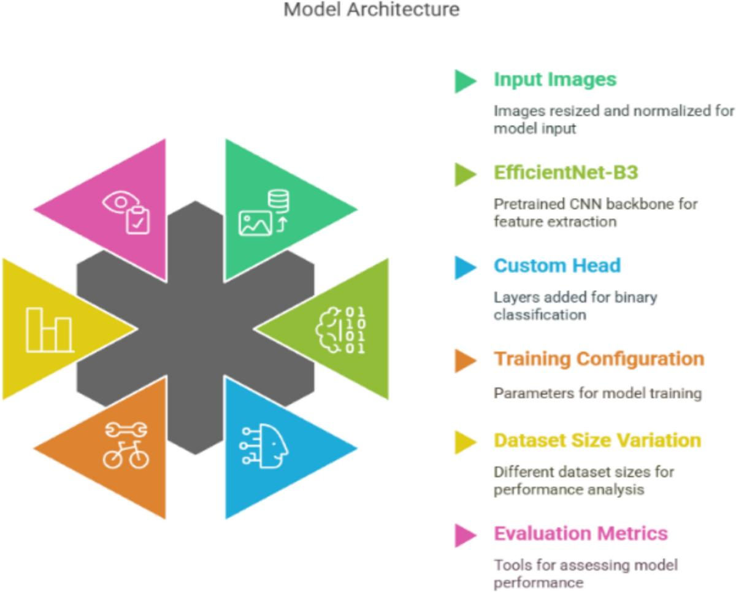
Flowchart
6

Slide 7
Applications
Social Media Monitoring – Detects and prevents the spread of fake or manipulated videos online.
Cybersecurity – Helps prevent identity theft, impersonation, and digital fraud.
Digital Forensics – Assists investigators in verifying the authenticity of multimedia evidence.
News and Journalism – Ensures credibility of news content by identifying fake media.
Banking and Authentication – Prevents misuse of facial recognition systems and fake identity verification.
Entertainment Industry – Helps monitor and control unauthorized use of deepfake technology.
7

Slide 8
Result / Output
Successfully developed a CNN-based Deepfake Detection System for identifying manipulated images and videos.
The model was trained using FaceForensics++ and DFDC datasets containing real and fake media samples.
Preprocessing techniques such as frame extraction, face detection, resizing, and normalization improved model performance.
CNN architectures such as Xception and ResNet effectively extracted visual and spatial manipulation features.
The proposed model achieved high performance with: • Accuracy – 94.5% • Precision – 95.0% • Recall – 94.0% • F1-Score – 94.5% • AUC – 0.96
Confusion Matrix Results: • True Positives – 480 • True Negatives – 475 • False Positives – 20 • False Negatives – 25
ROC Curve and performance graphs confirmed strong classification capability and reliable detection performance.
8

Slide 9
Conclusion
This project presents a CNN-based approach for detecting deepfake images and videos effectively.
The model is capable of identifying manipulated content by analyzing visual inconsistencies and hidden patterns.
Experimental results show that deep learning techniques can achieve high accuracy in deepfake detection.
The proposed system helps improve digital security, media authenticity, and reduces the spread of misinformation.
9

Slide 10
Thank You
10

